Slide 1
Angular Reactive Forms
INTRODUCTION

Slide 2


Slide 3

Module Overview
Angular Forms
Demo Form and Sample Application Course Outline

Slide 4





Angular Forms
Template
Component Class
Server Database

Slide 5








Angular Forms
Template- driven
Reactive
(Model-driven)

Slide 6
Angular Forms
Template-driven
Easy to use
Similar to AngularJS
Two-way data binding -> Minimal component code
Automatically tracks form and
input element state
Reactive
More flexible ->
more complex scenarios
Immutable data model
Easier to perform an action on a value change
Reactive transformations -> DebounceTime or DistinctUntilChanged
Easily add input elements dynamically Easier unit testing

Slide 7
Prerequisites
Required
Not Required
Angular modules (NgModule)
Components
Templates
Binding
Services
Routing
Prior Angular forms knowledge

Slide 8

Checklist
Review module concepts
Code along
Revisit as you build

Slide 9
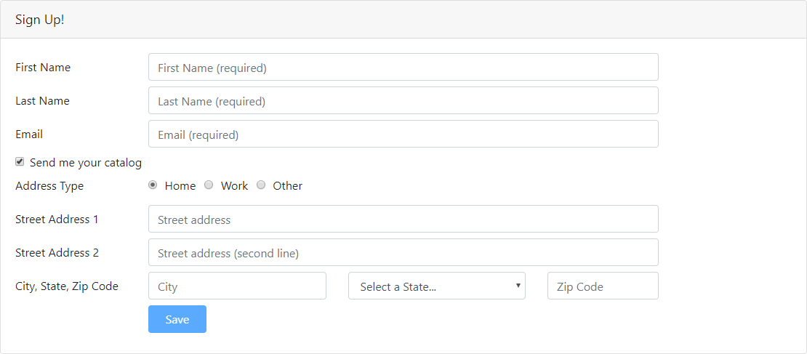
Demo Form

Slide 10

Demo
Sample Application in Action
Reactive form
Routing
Data Access Service

Slide 11
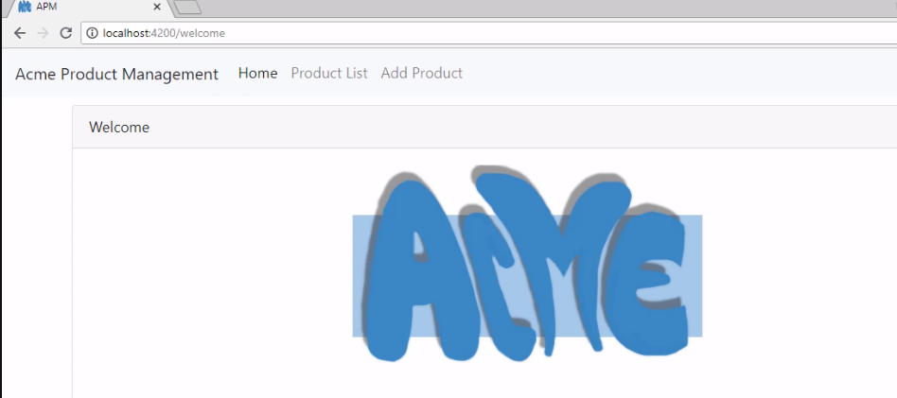

Slide 12
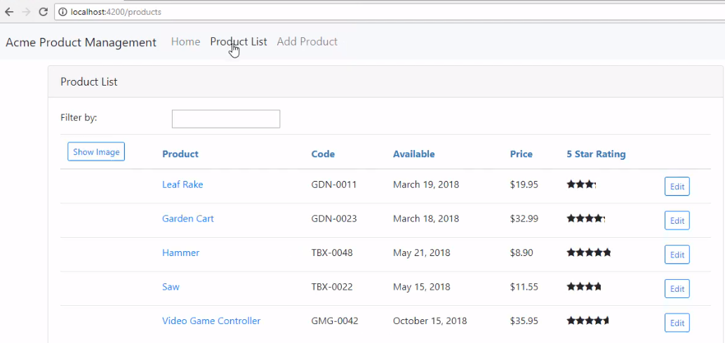

Slide 13
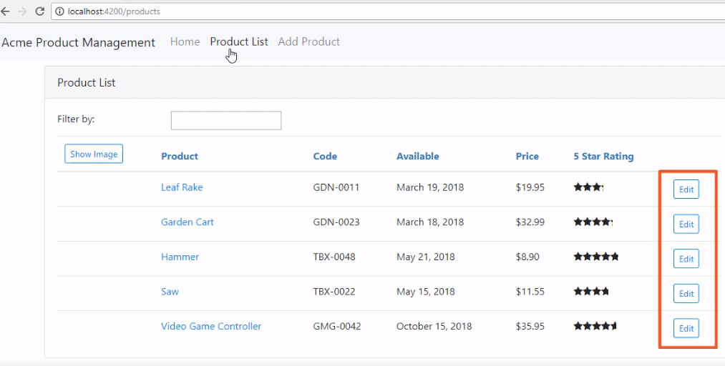

Slide 14
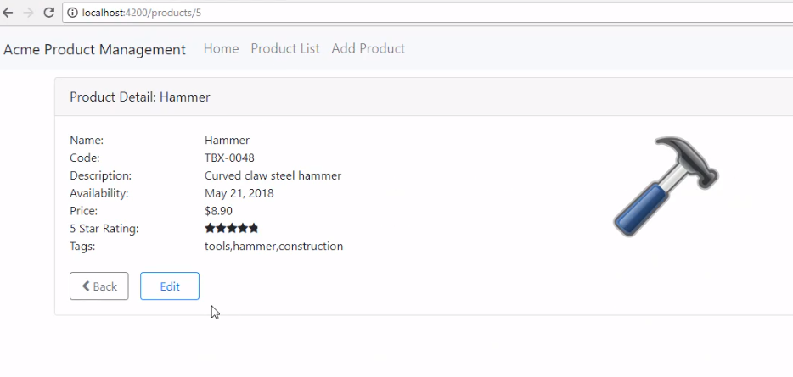

Slide 15
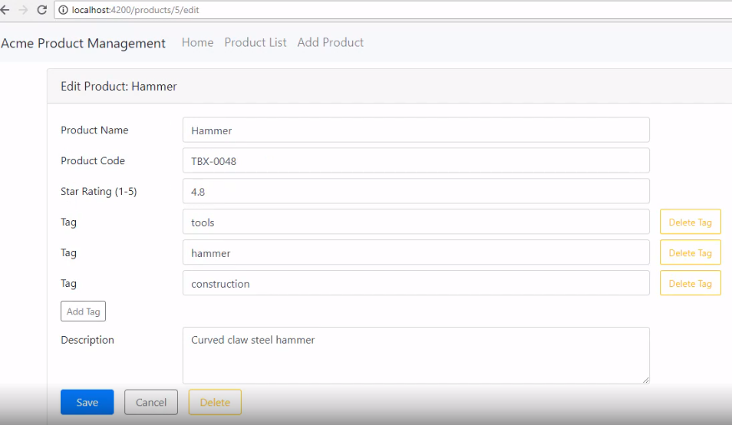

Slide 16
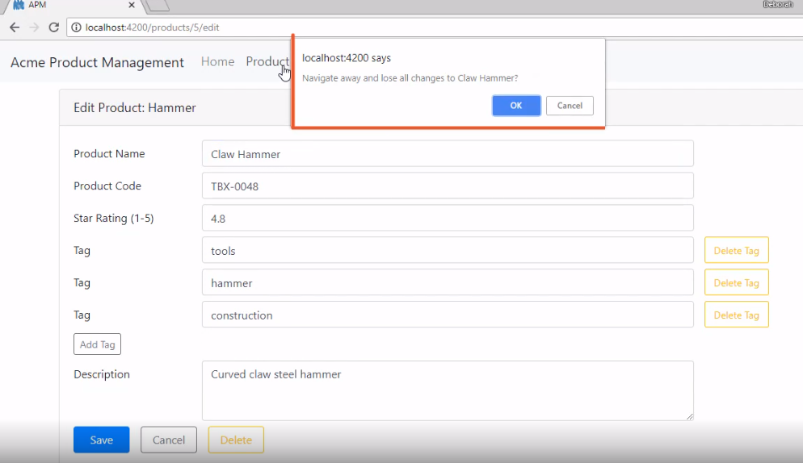

Slide 17
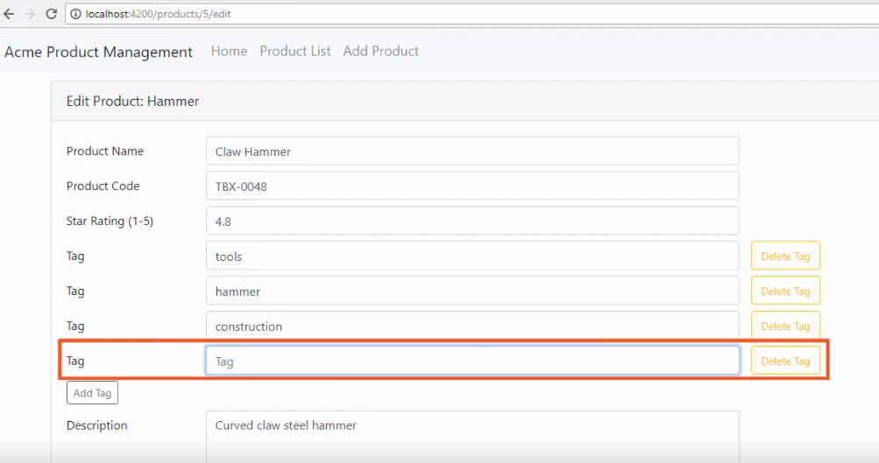

Slide 18
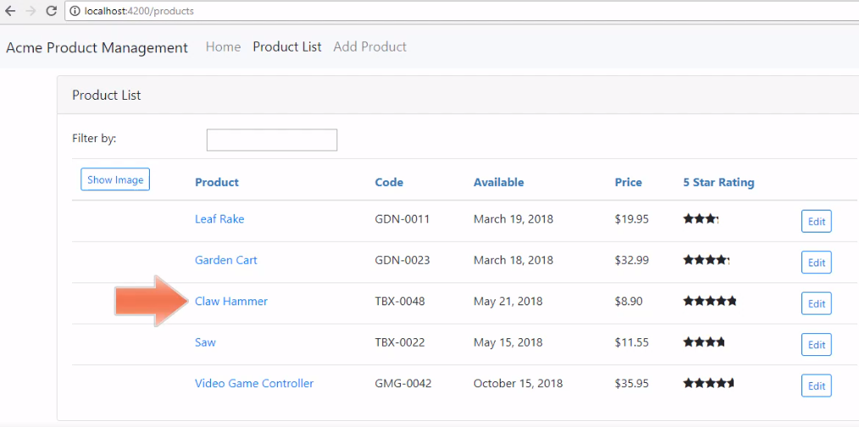

Slide 19
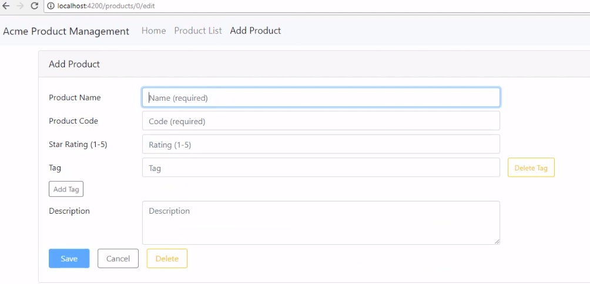

Slide 20
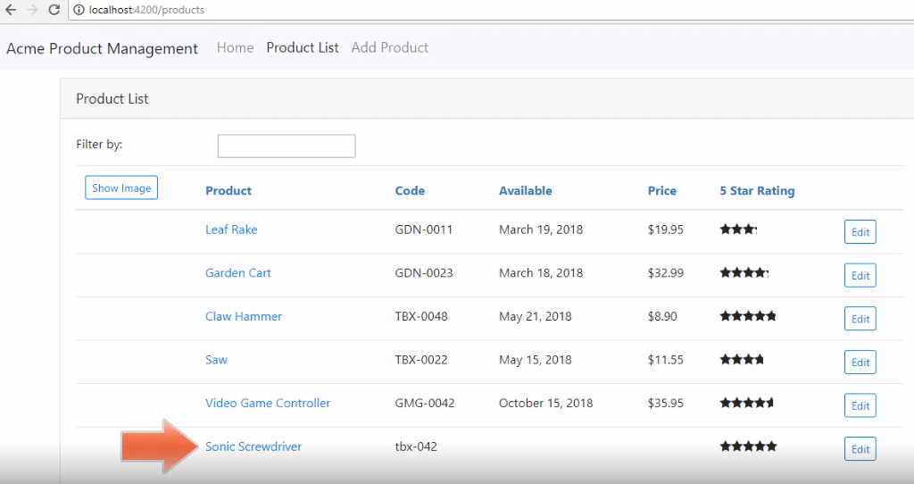

Slide 21
Template-driven vs. Reactive Forms
Building a Reactive Form Validation
Course Outline
Create, Read, Update and Delete (CRUD) Using HTTP

